Slide 1
Simple exponential smoothing (SES)

Slide 2
Introduction
Exponential Smoothing is an elementary and pragmatic technique used for forecasting where the forecast is made through the exponentially weighted average of prior observations.
It analyzes data from a specific period of time via providing more importance to recent data and less importance to former data
This method produces “smoothed data”, the data that has a noise removed, and allows trends and patterns to be more clearly visible.

Slide 3
Idea:-
Idea:-Forecast future values using a weighted average of all previous values in the series.
Uses:-Forecast a series with no trend and no seasonality
Types:- 1-Simple exponential Smoothing (For series with no trend or seasonality) Good for our case!
2-Holt’s Exponential Smoothing (For series with trend but no seasonality)
3-Winter’s Exponential Smoothing (For series with trend and seasonality)
Key concepts:-Smoothing Constant
Advantages: Simple, Popular and adaptive0

Slide 4
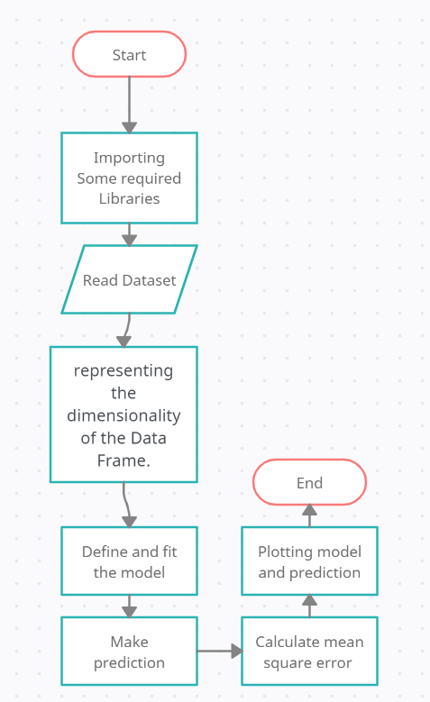
Flow Chart

Slide 5
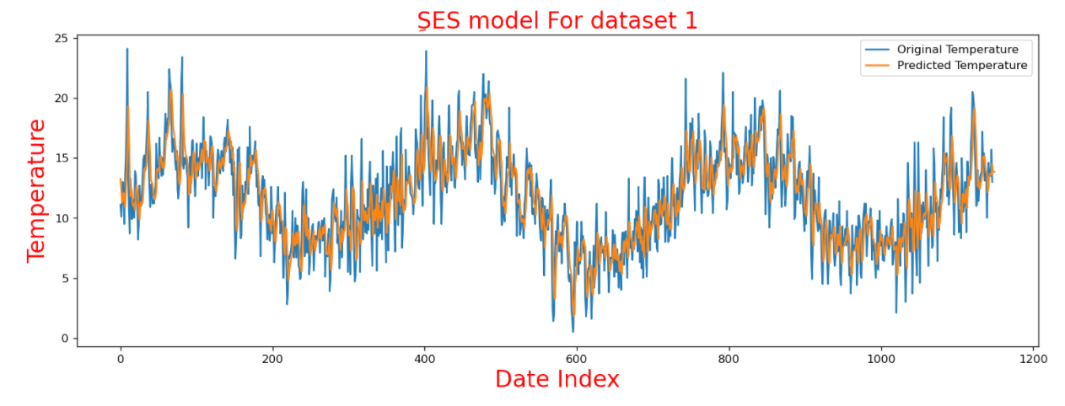
Plotted graph of first dataset
Plotted graph of second dataset
Mean_sqr_error=2.16876874275847

Slide 6
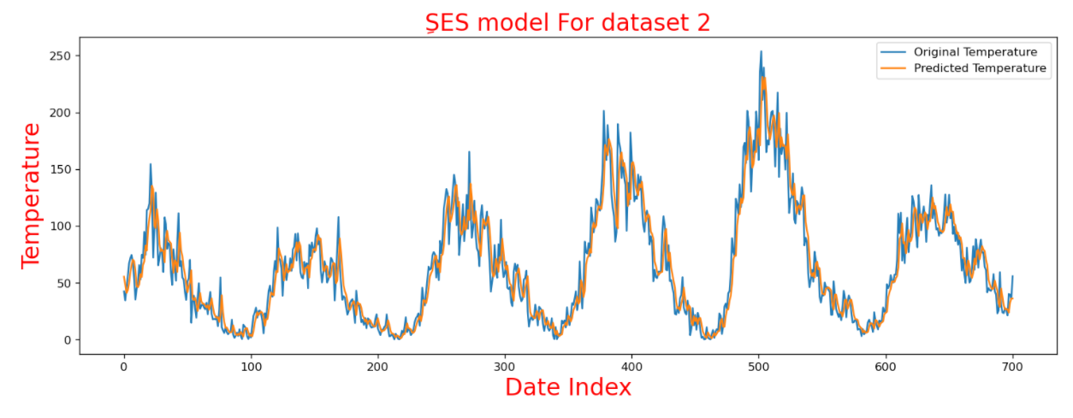
Plotted graph of second dataset
Mean_sqr_error=17.21472624307182

